Slide 1

Facilities Master Planning
Process and Timeline
SBVC College Council Meeting
Date: 03/13/2024

Slide 2

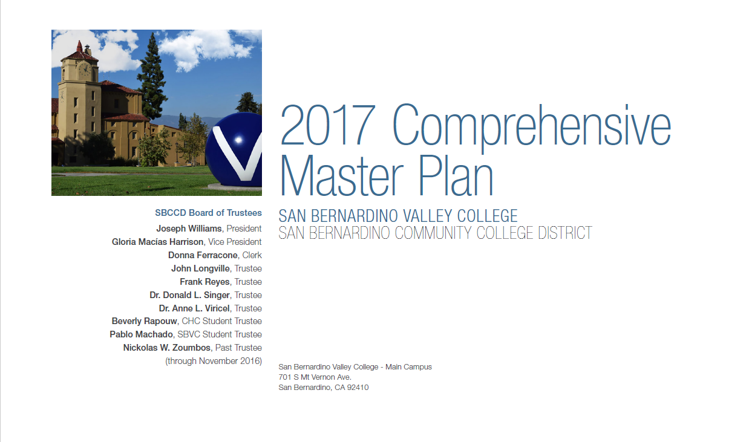
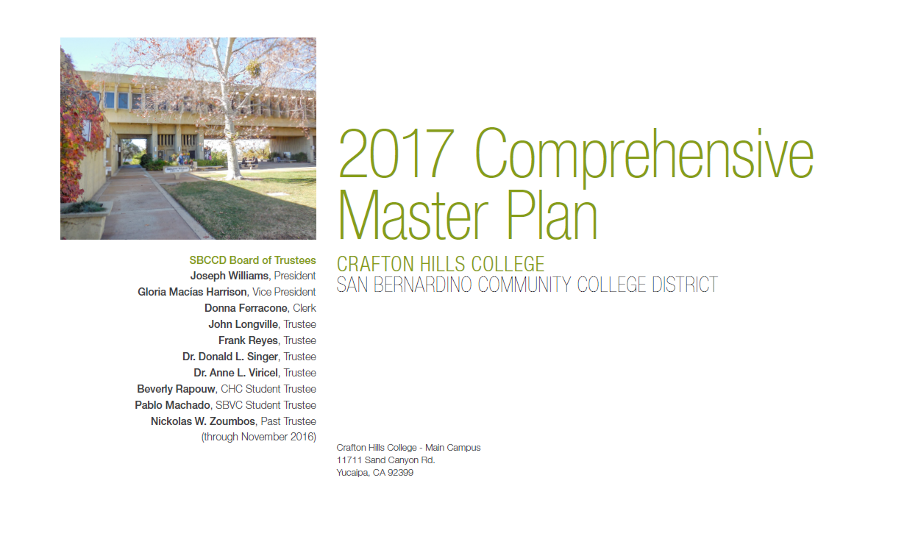
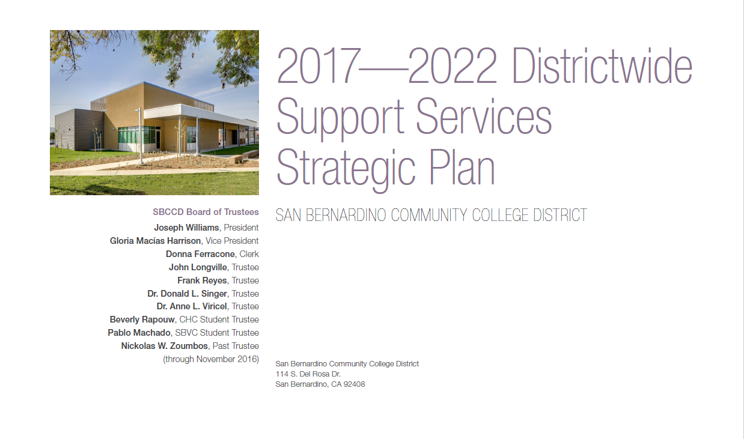
Background

Slide 3
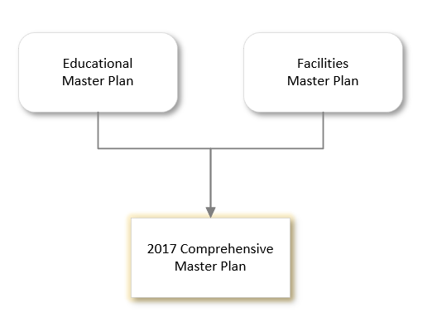
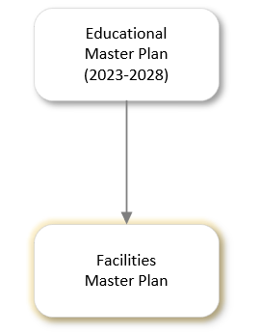
Past vs Present Approach
2017 Approach
Current Approach
Concurrent Development

Slide 4



FMP Development Process
Facilities Analysis
Space Utilization Study
Facilities Conditions
Infrastructure Condition
Circulation & Flow
Needs & Assessment
Educational Master Plan Link
Academic and Programmatic Needs
Growth and Expansion Potential
Student Services and Support Areas
Recommendations
Modernizations & New Buildings
Infrastructure Upgrades
Technology Enhancements
Safety and Accessibility Improvements
Sustainability Initiatives

Slide 5
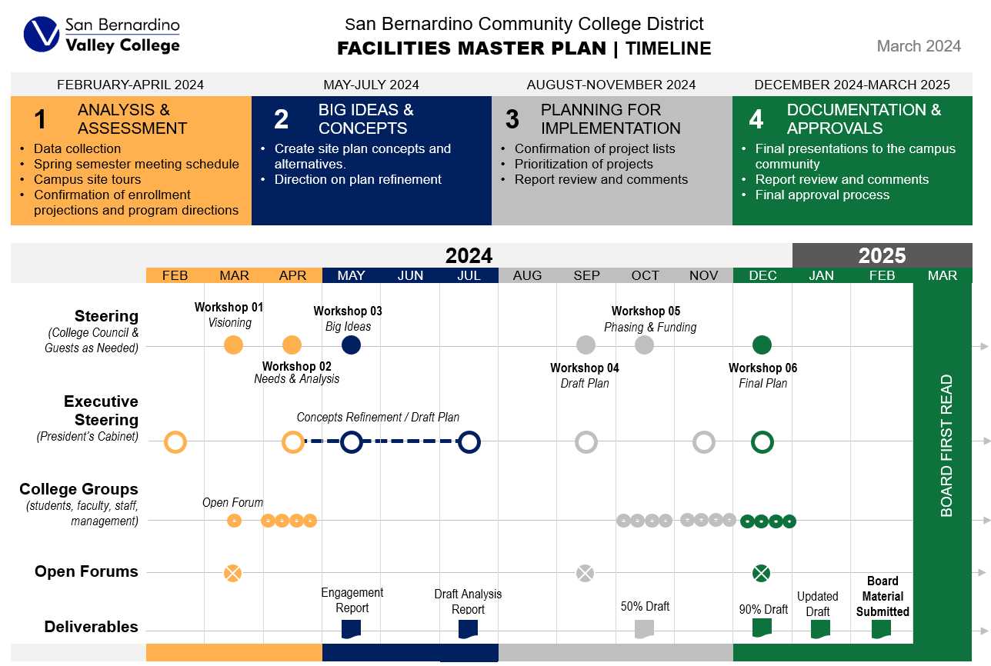

Slide 6
