Slide 1
Institute of Media Arts
A Project of the Film, TV, Media Department at San Bernardino Valley College

Slide 2
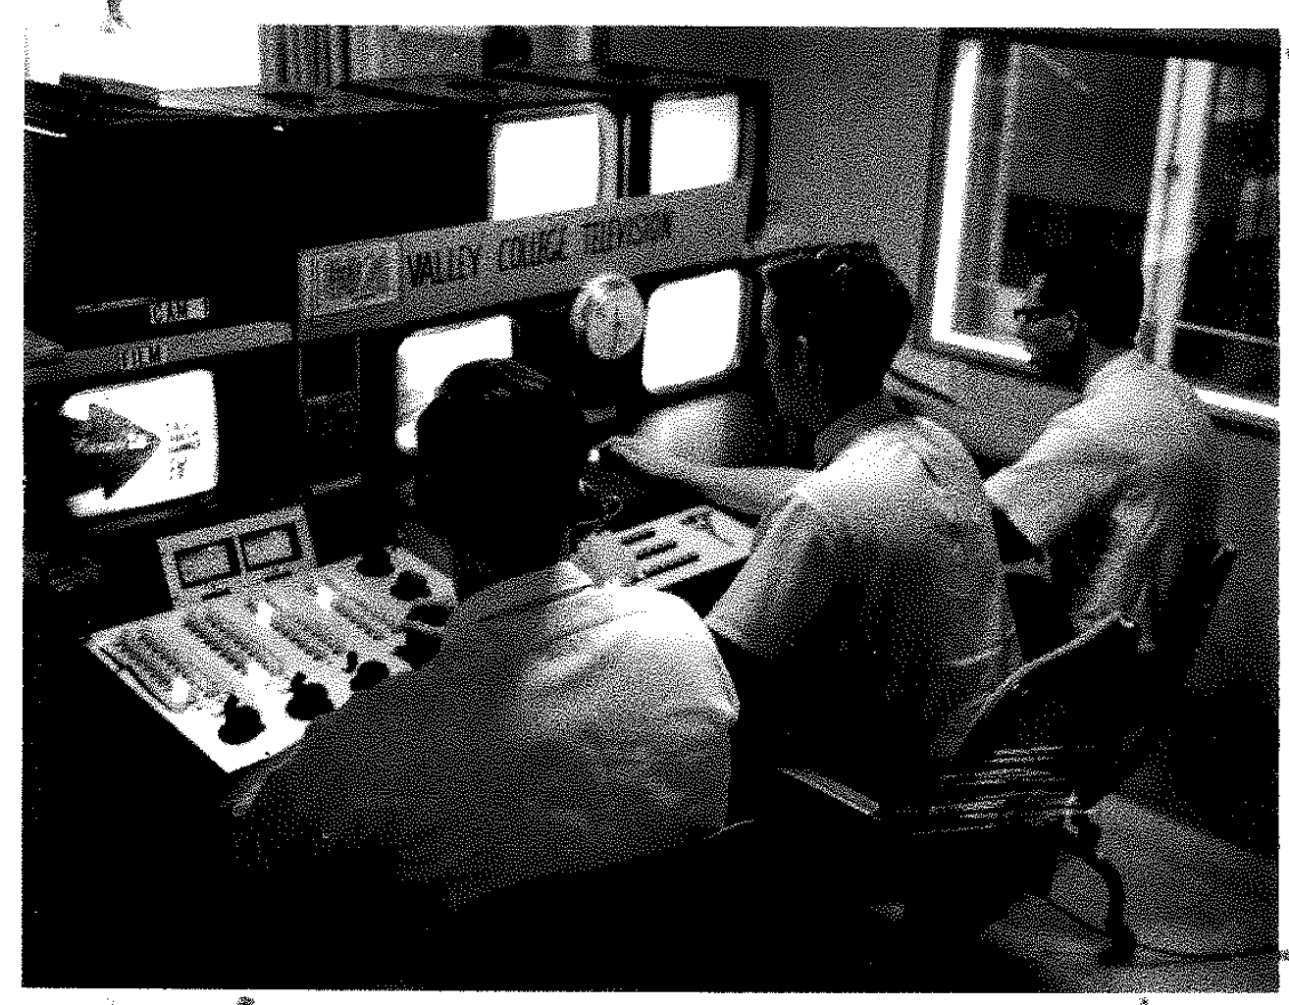
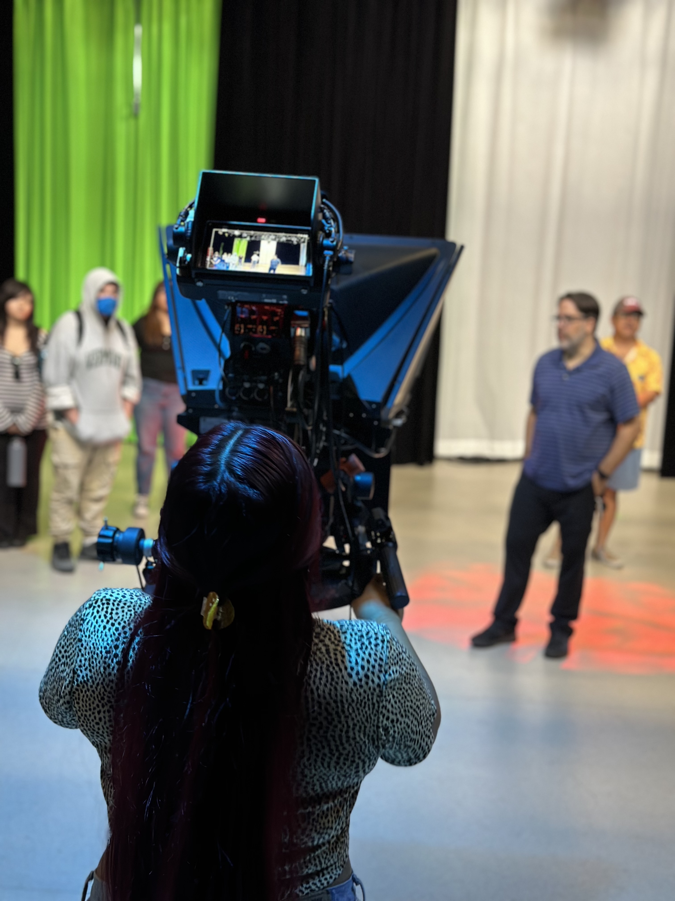
Background
SBVC Began Teaching Telecommunications in 1962
KVCR Radio Began in 1953
KVCR TV began in 1962
Bandwidth Auction set up current budget allotment 2018-2019
Modernization of facilities and instructional technology
Updating of curriculum to meet current Film, Television and Media Trends

Slide 3
Models
STEM MESA for Media Students
Center for Media and Design Santa Monica Community College
Institute of Media Arts at San Bernardino Valley College
Media as an economic sector ranks 2nd in the state source California.com
Media is
FTVM
Art
Theatre
Music
Modern Languages
English
Communications Studies
Basically, the Humanities

Slide 4
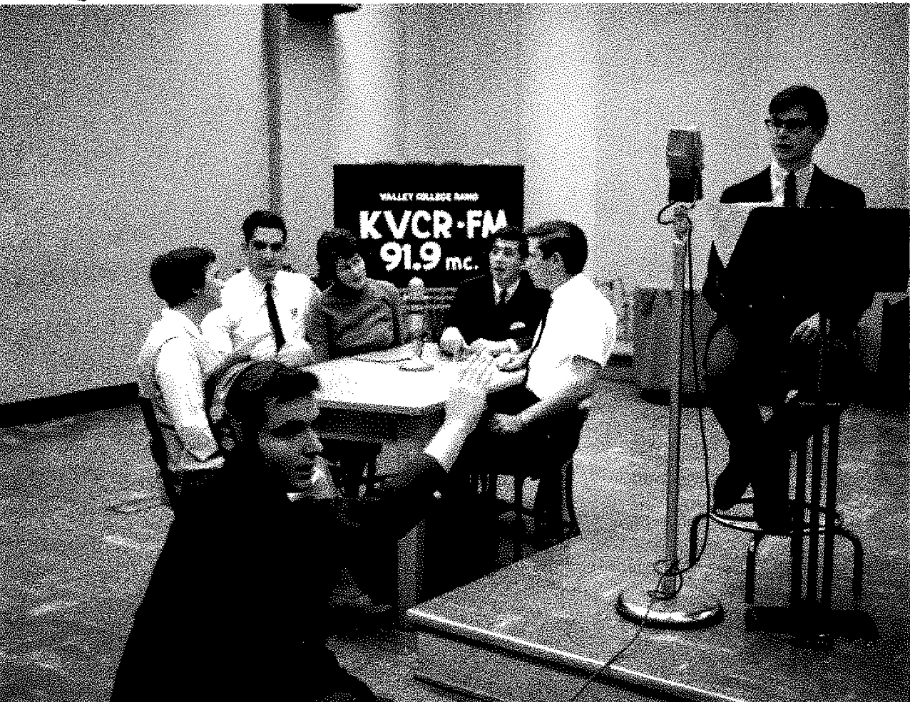
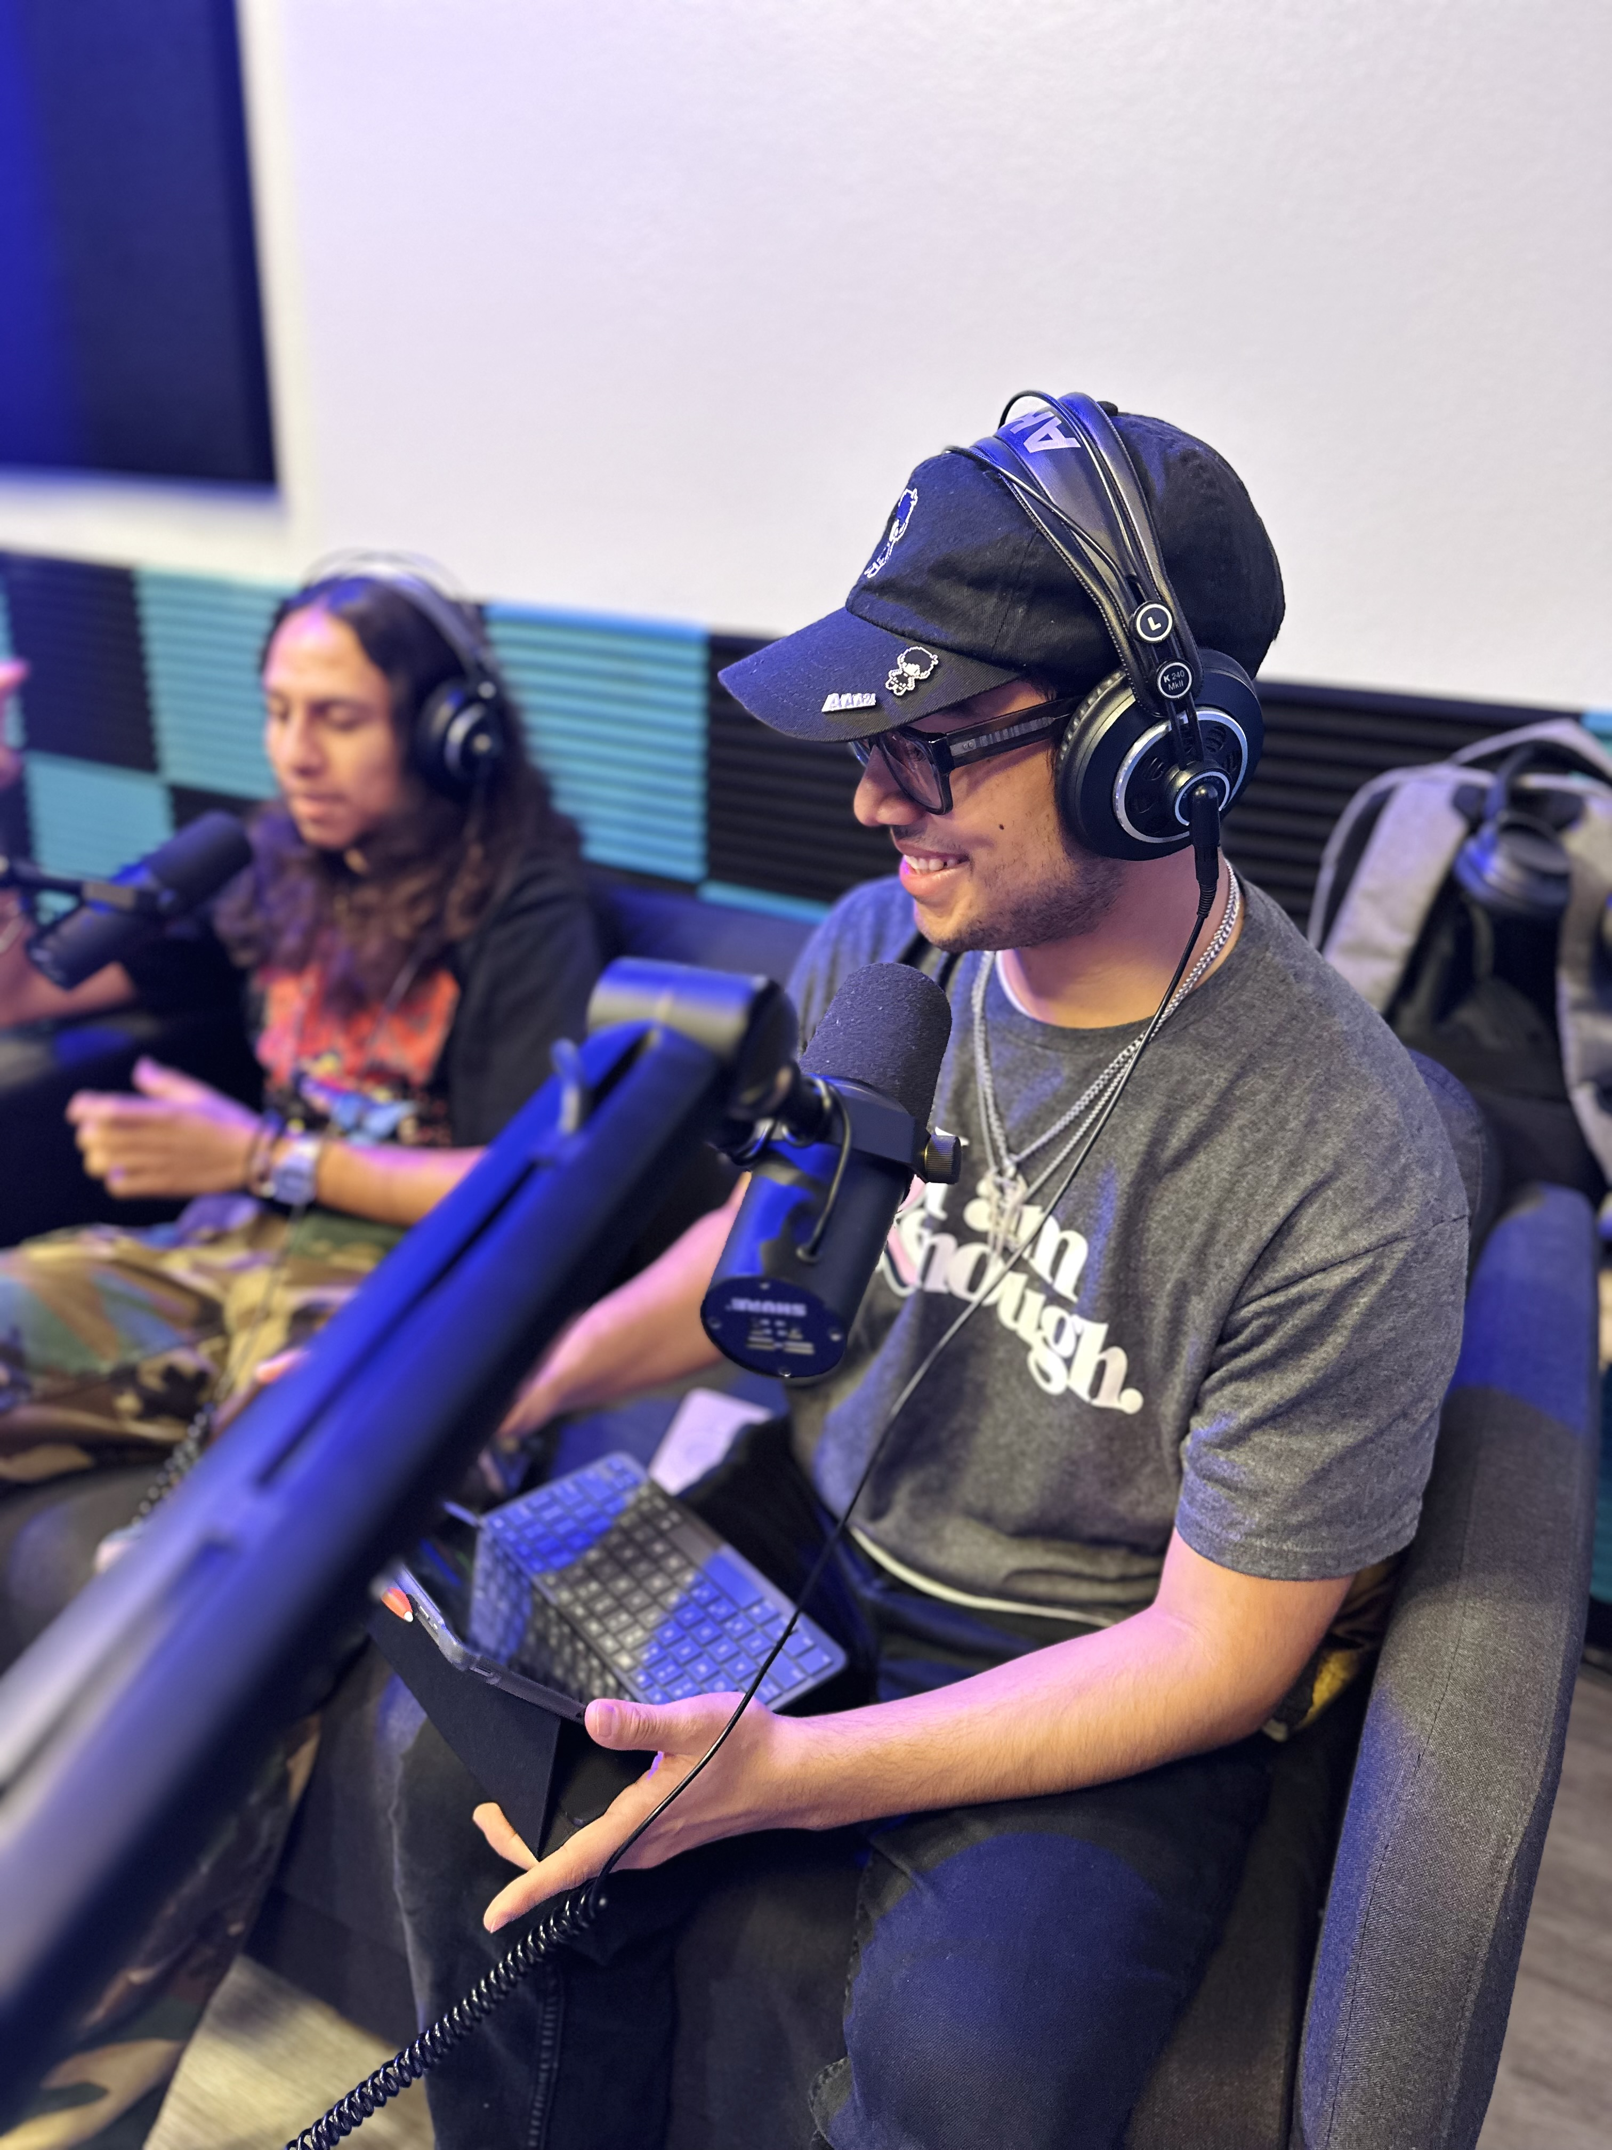
Items of Note
Updated Curriculum
Updates to both studio and classroom spaces
Release time for Full-time faculty
Outreach
Festivals
Fellowship Program –
Guided Pathways Model
Create a path – Department Maps
Choose a path
Stay on the path
Intentional Outcomes
Notes:
From radio to podcast

Slide 5
Curriculum Changes since 2018
New Department Name
Film Television Media
Updated all classes to incorporate new tech
Added Courses:
Broadcast News
Sports Broadcasting
Media Practicum (Transferable) – Internship or Non-Scripted Project Based course
More GE Courses – Ethnicity and Identity in Media and Women in Cinema coming Fall 2026
Several Non-credit: Steadicam, Producing 101, Film Cinematography, and Grip and Electric
Film Photography coming Fall 2026. Cross listed with Art
Notes:
It’s not pretending

Slide 6
Interdisciplinary Curriculum
Degrees
Film Associates
Arts – Post Production and Camera Path
Music – Post Production Path
Theatre – Directing Path
Audio Associates
Music
Theater
Journalism AS-T
English
Communications Studies
Art
Certificates
Art – Digital Marketing coming fall 2025
History – Historical Documentary
English – Journalism Certificate
Communications Studies – Journalism and Digital Marketing Fall 2025
Notes:
It’s not pretending

Slide 7
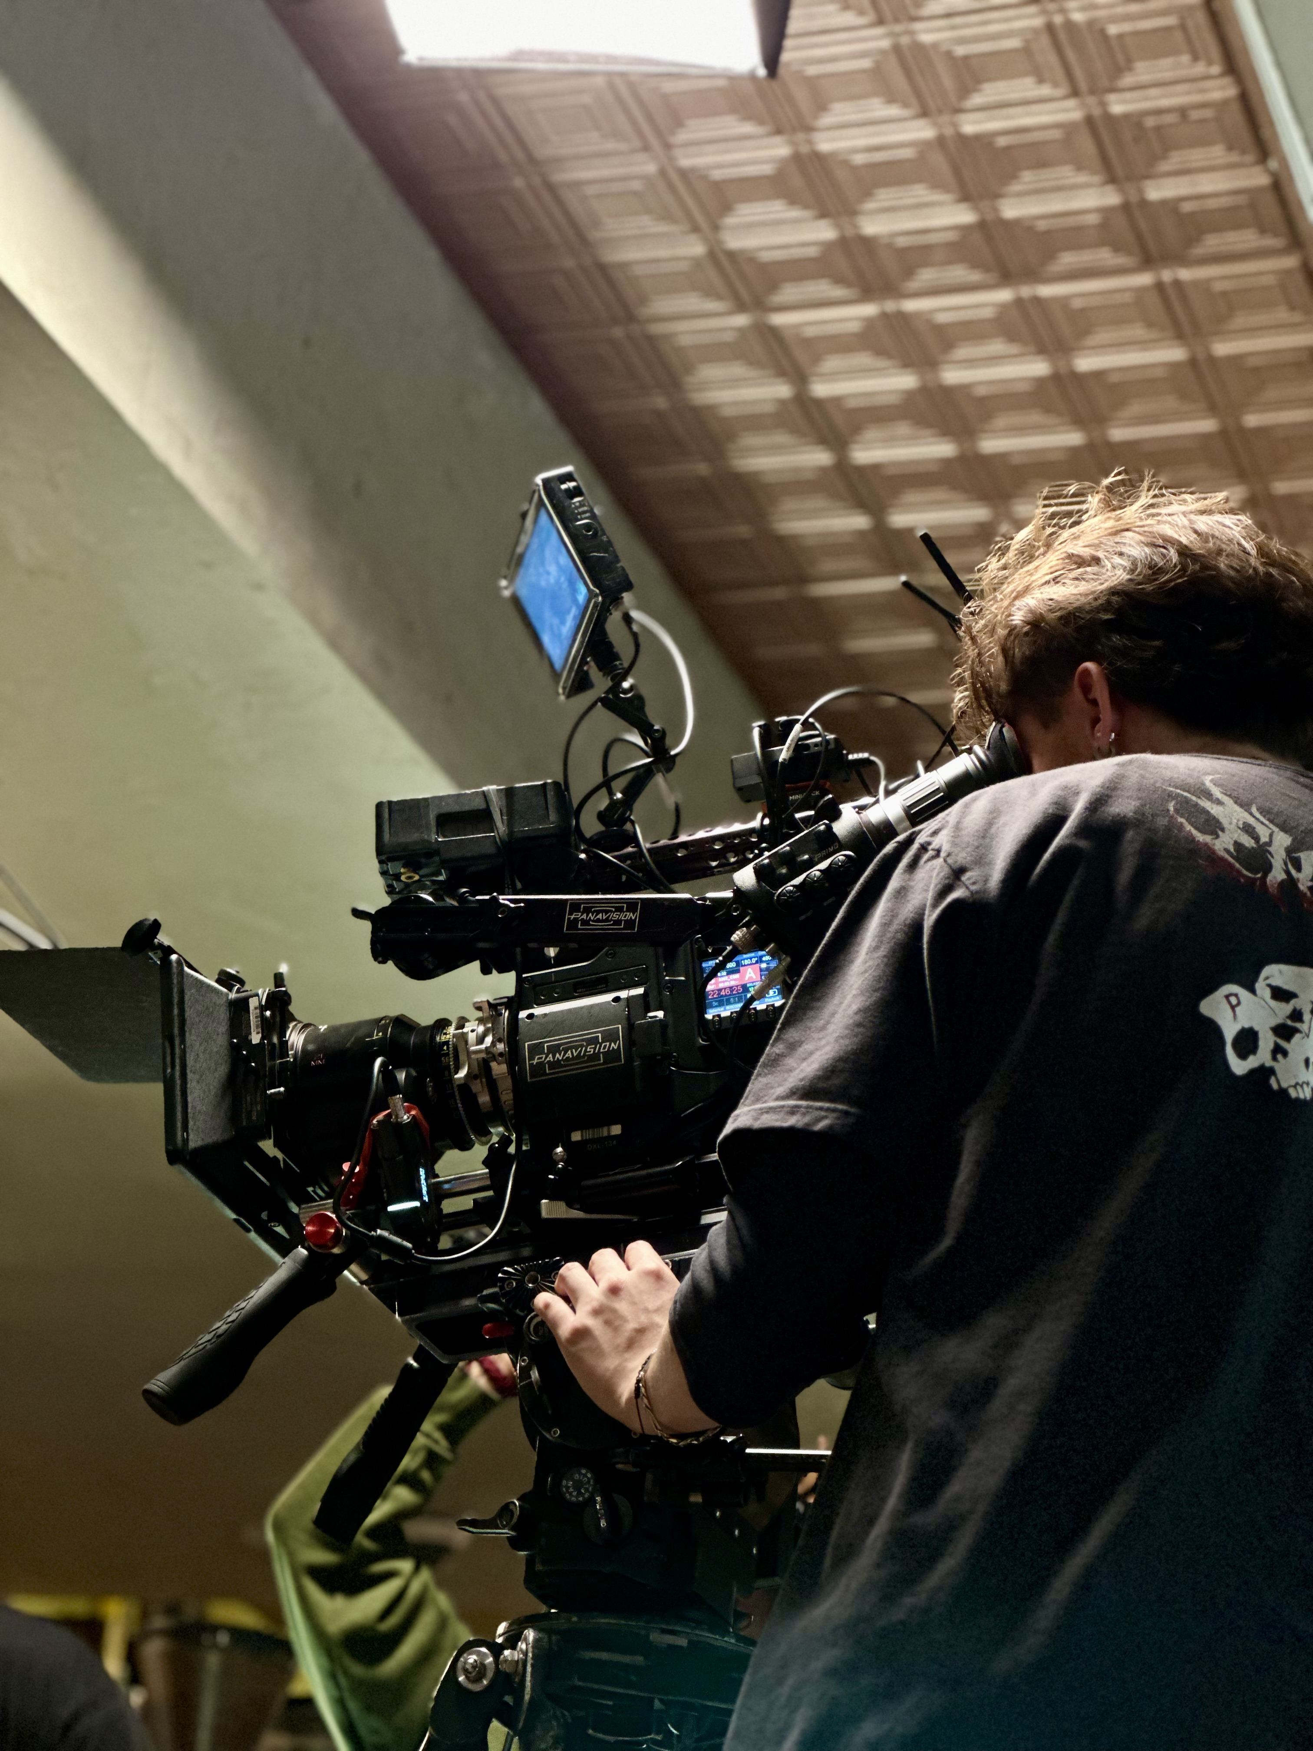
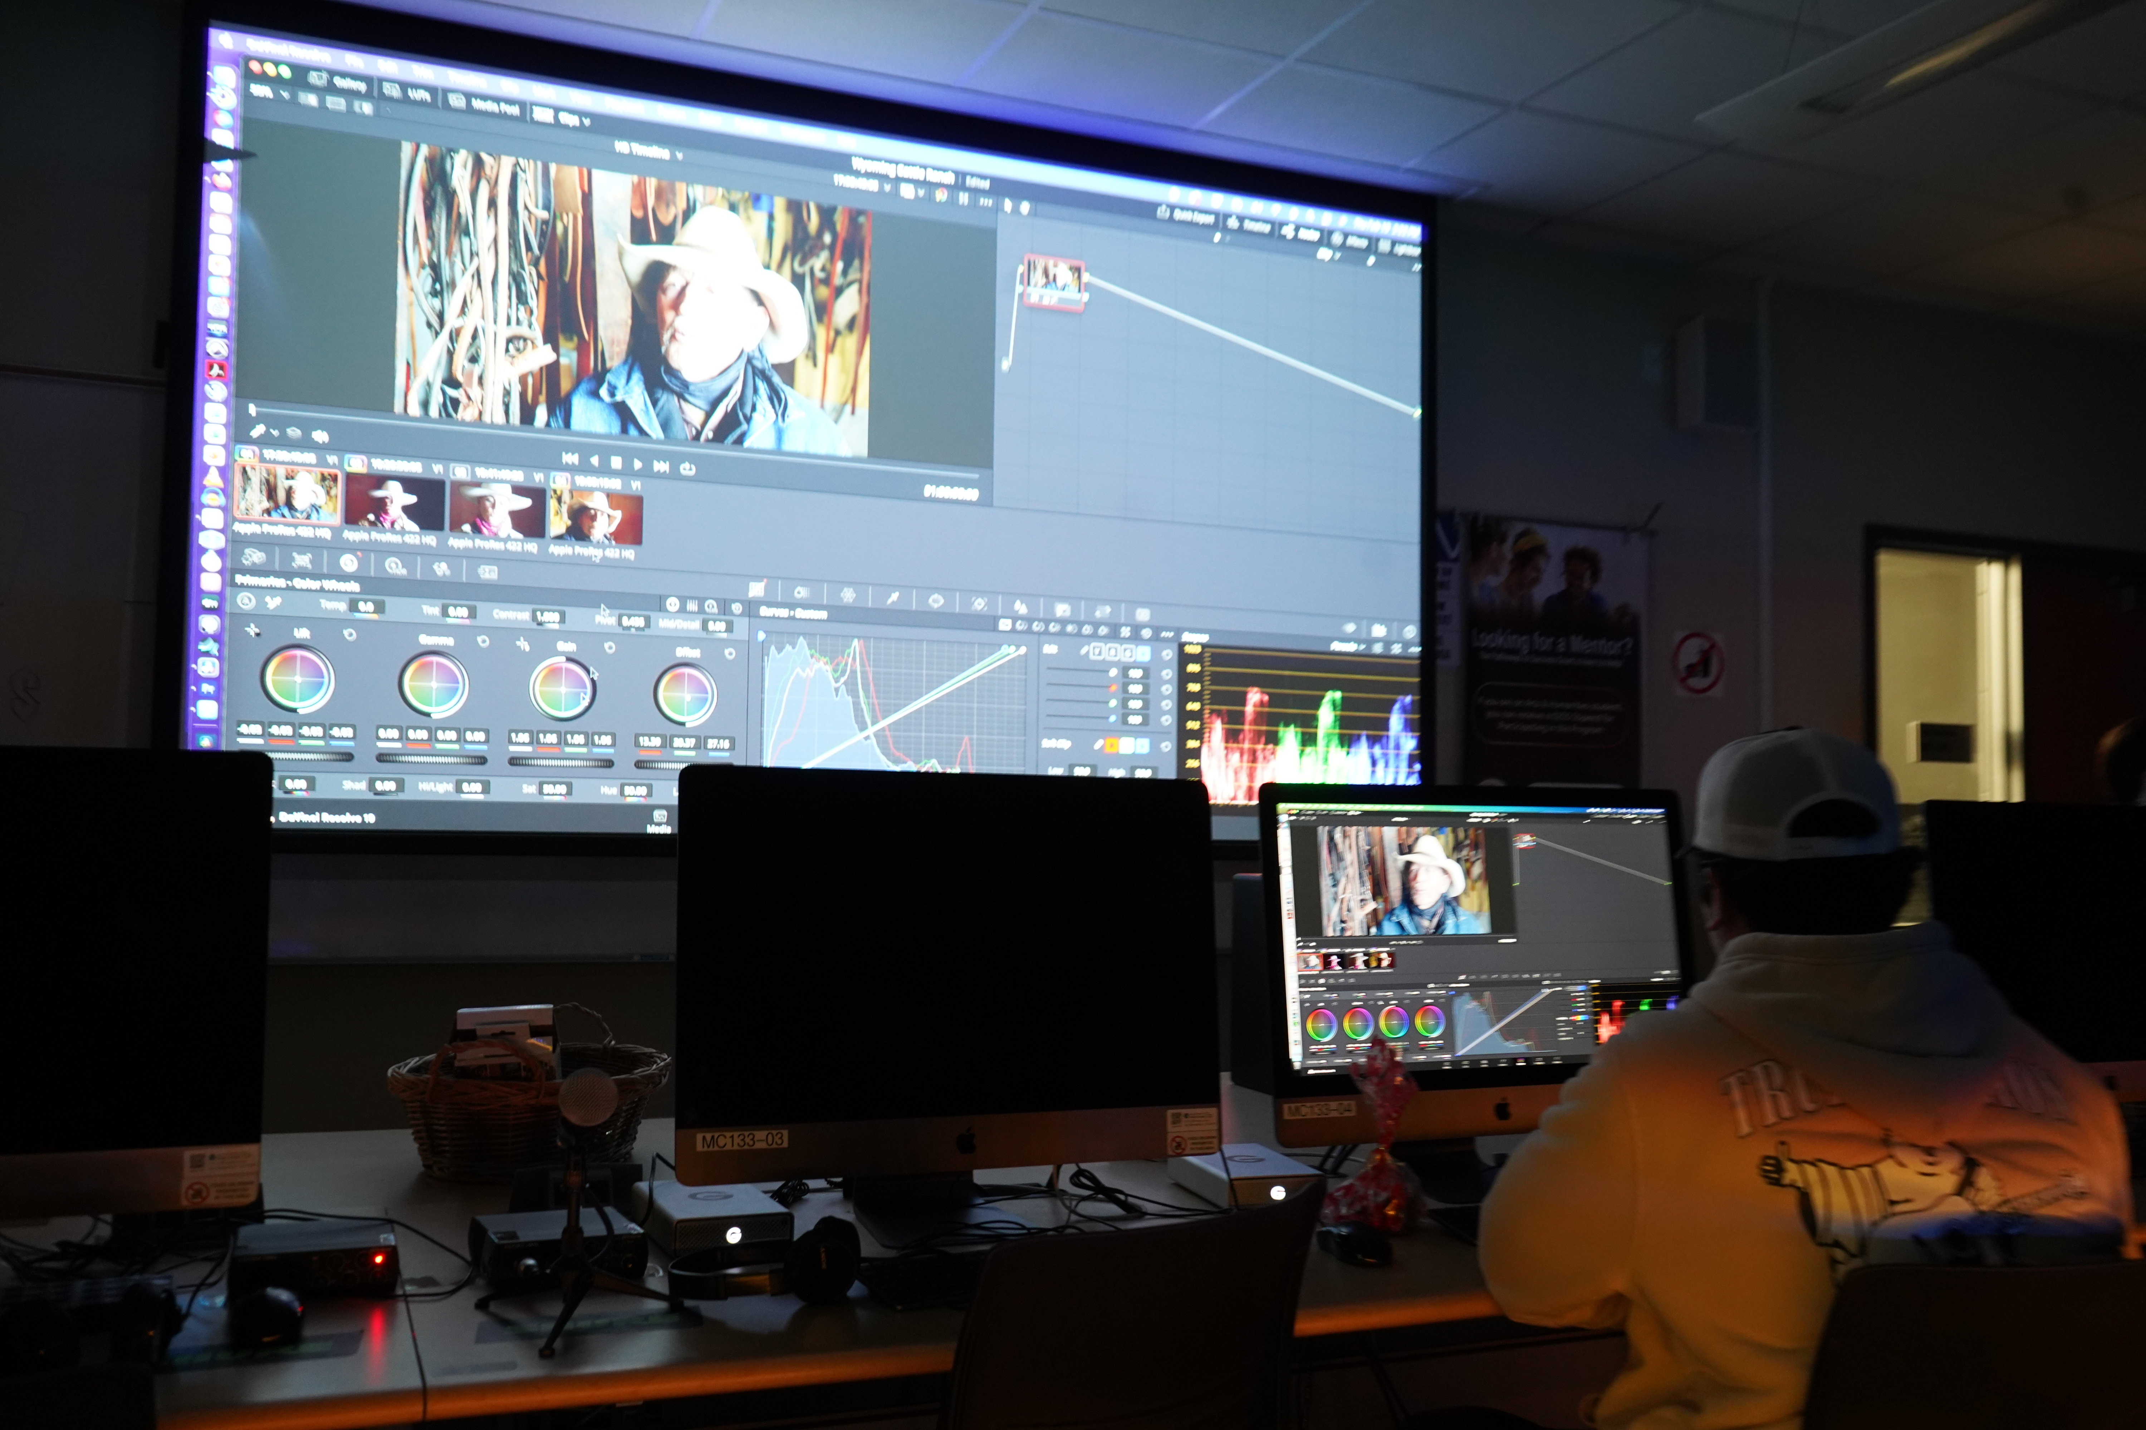
Investment
TV Studio - Auction
Podcast Room - Auction
Grip Truck – Strong Workforce
Steadicam – Perkins
Motion Capture – Perkins
Production Insurance
Cinema grade cameras – Auction and Strong Workforce
Notes:
Leveling up our students.

Slide 8
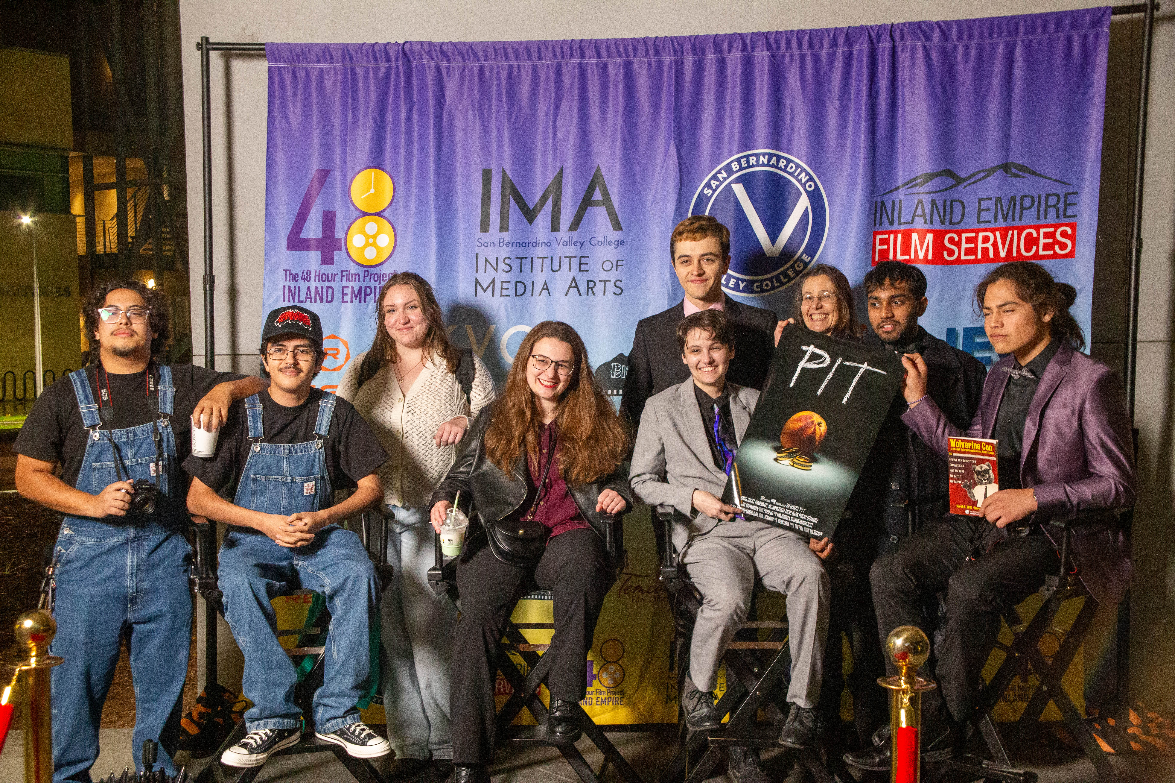
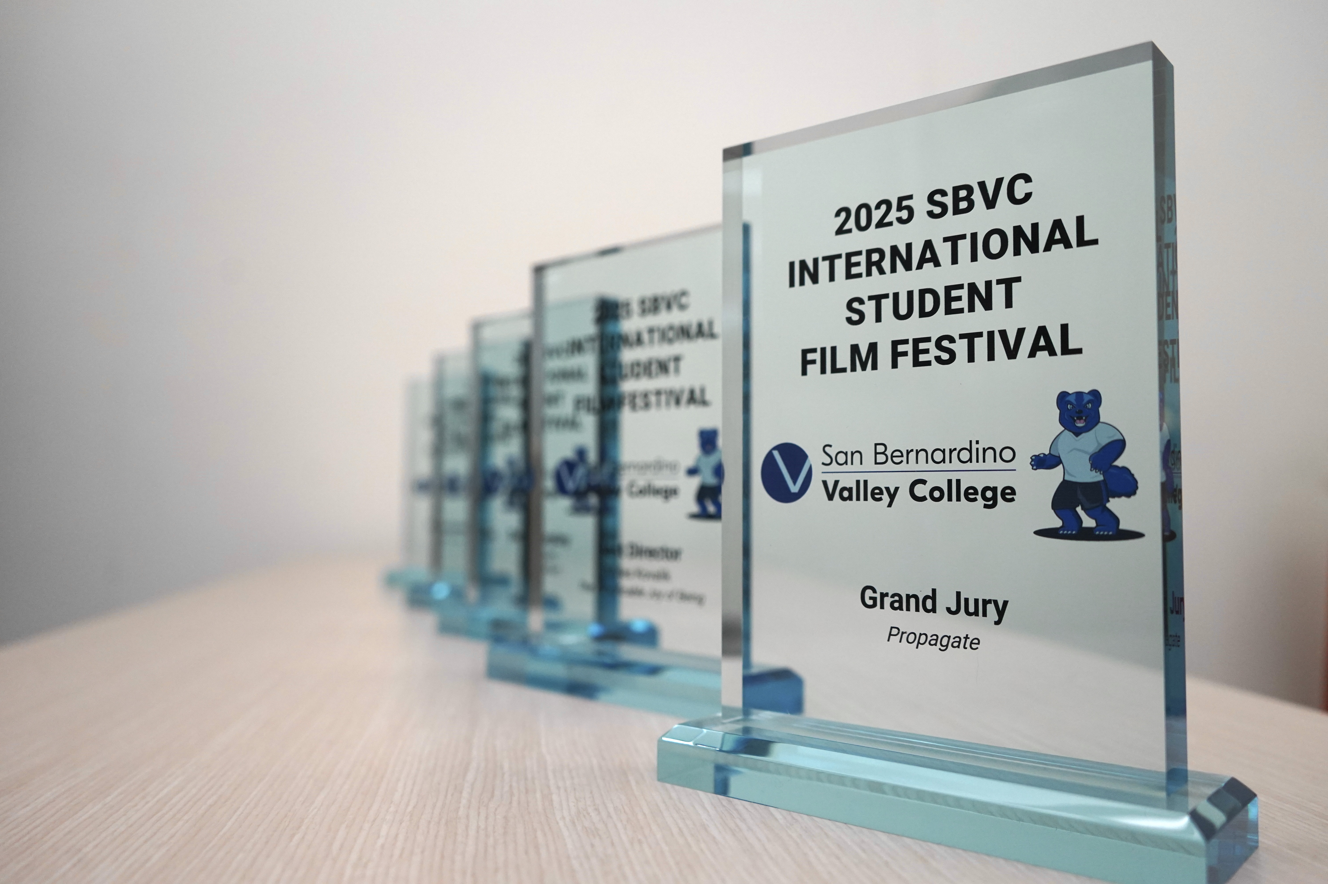
Outreach
High School Visits
Fall of each academic year
Then some in the spring
Festivals
48 Hour Film Festival – International Open to all
Wolverine Con - International for Students only
Over 150 High School Students attended this year
Career Development Events – Meet the Pros Mixer
Tours
Orientations
Spring
Early Fall
Community Partnerships
Redlands Bike Classic
Inland Empire Film Commission
Orange Show Speedway
Local Businesses
Notes:
It’s not pretending

Slide 9
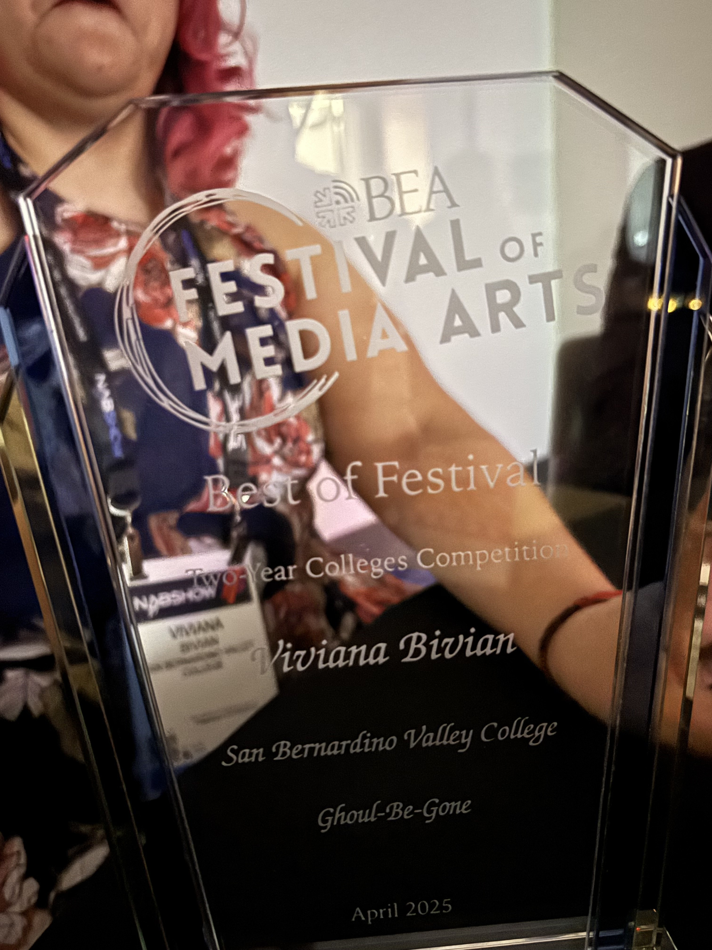
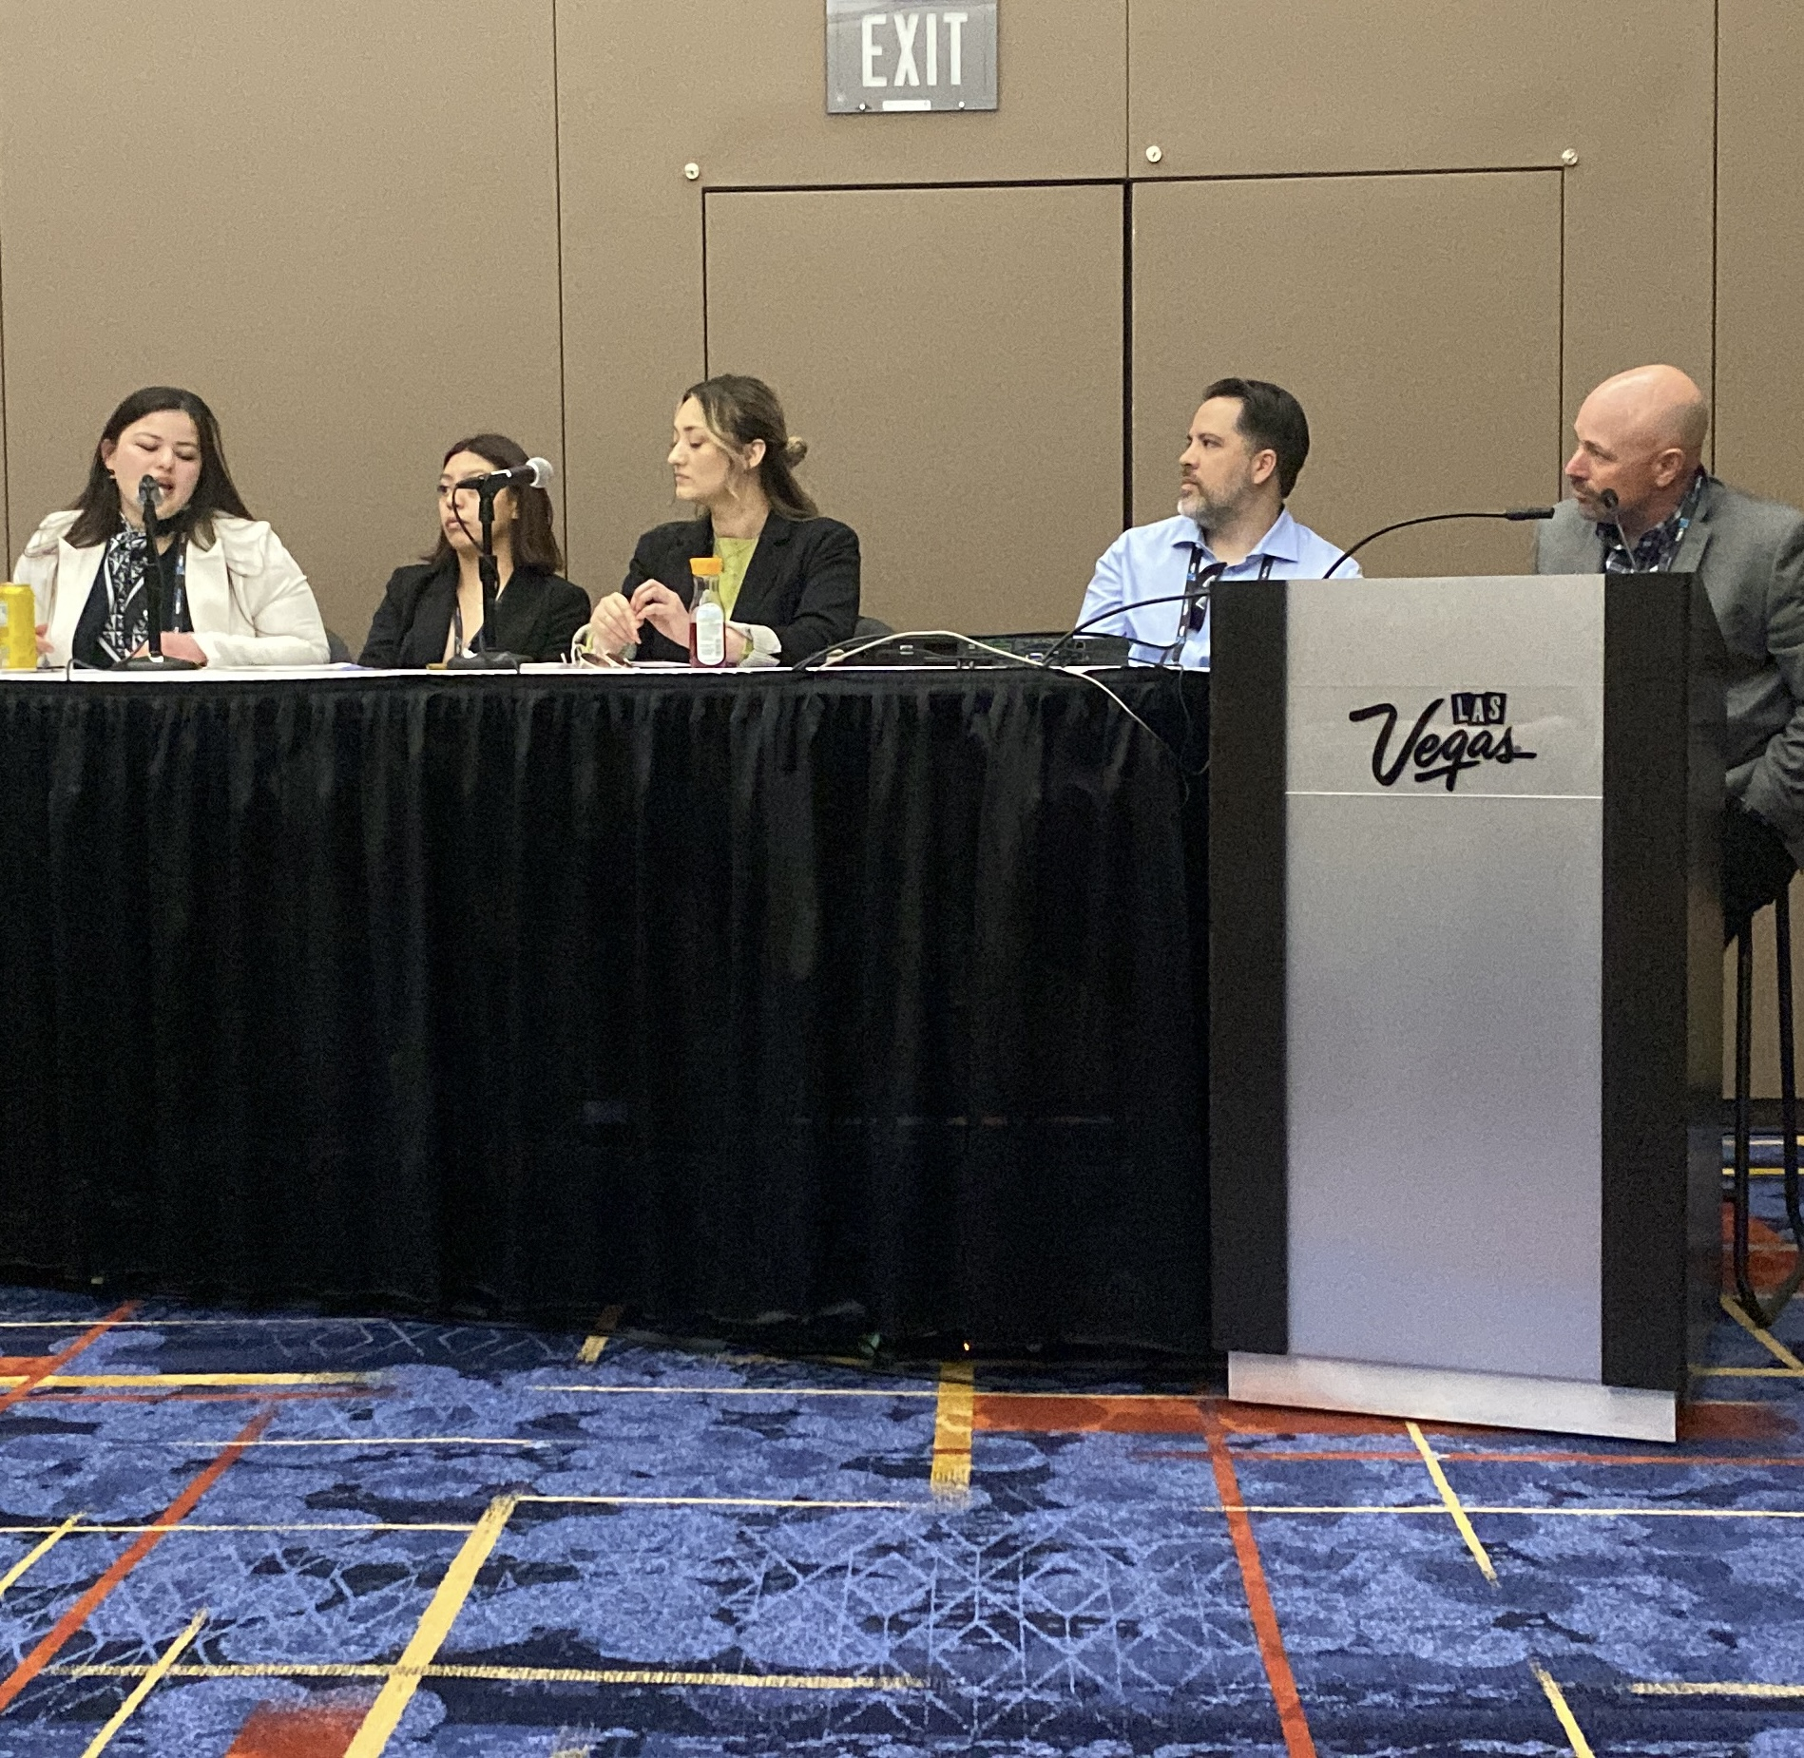
Outreach
Broadcast Educators Association
Annual Conference
Presented a panel in 2024
Chair the 2-Year category for Festival of Media Arts
University Connections
CSUSB
Cal State LA
UCR
LaVerne
UNLV
Notes:
Last year we present ed at BEA this year a student won for best 2-year

Slide 10
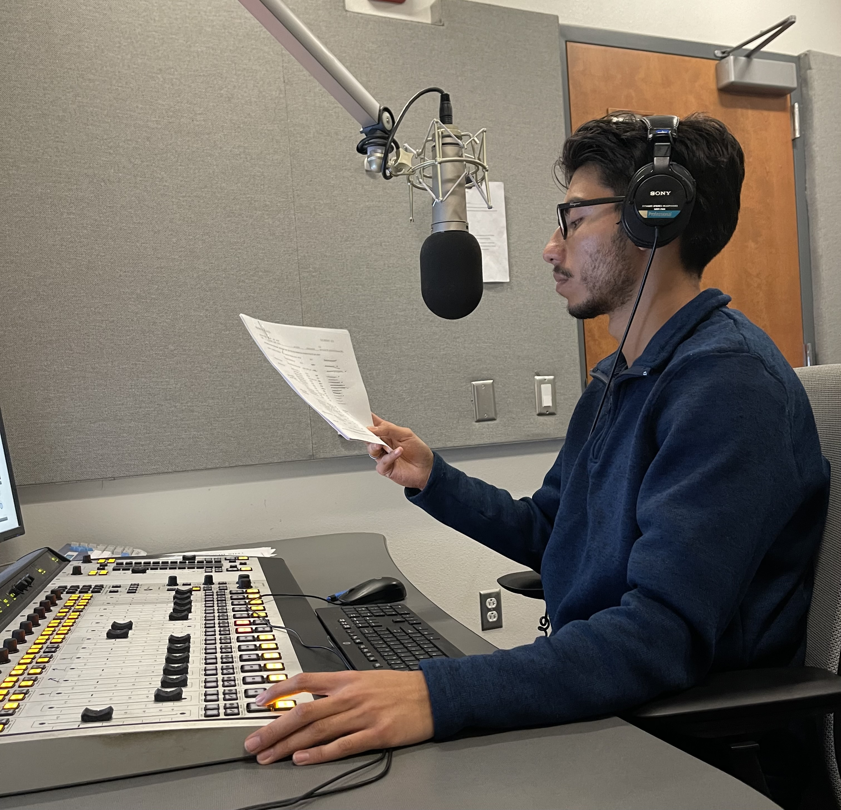
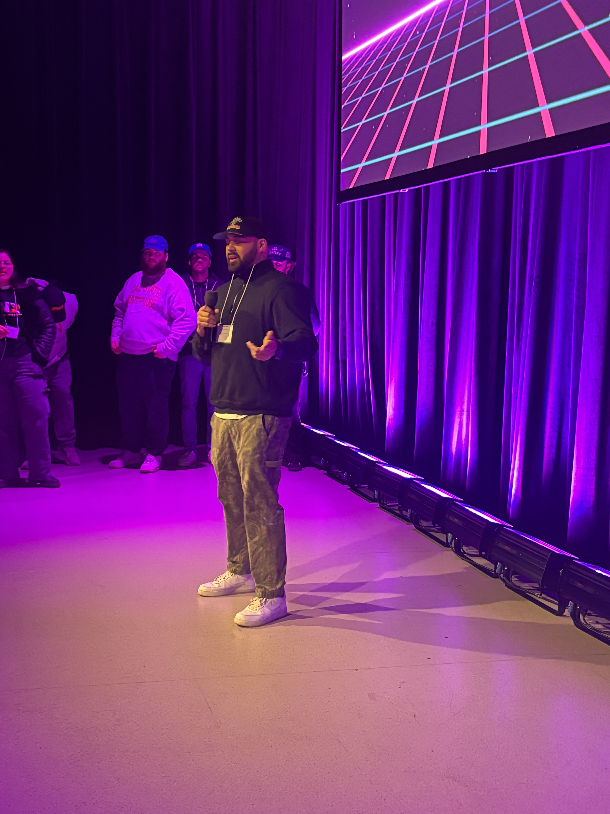
Fellowship Program
Keeps students on path
Collaboration with CTE Counselor
Annual Check in on Ed Plan
Open lines of referral
Peer Mentor
Workshops on all things FTVM
Career Workshops
Department Interns
Expanded Lab and studio hours
Two full-time lab techs
Temporary Full-time faculty
Intentional Outcomes
Distribution of student projects
KVCR and Festivals
Internship Placement
KVCR
Local Businesses
Other production companies
Transfer Degree increase
Notes:
Anuar is a current paid intern at KVCR, and will be transferring to CSUN in the fall.
From our meet the pros mixer; this is Juan Ortiz, class of ‘21 and graduate of CSUDH and now a production coordinator talking to our students and local high school students about our program and career paths.

Slide 11
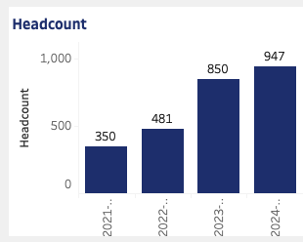
The Numbers
Overall Headcount

Slide 12
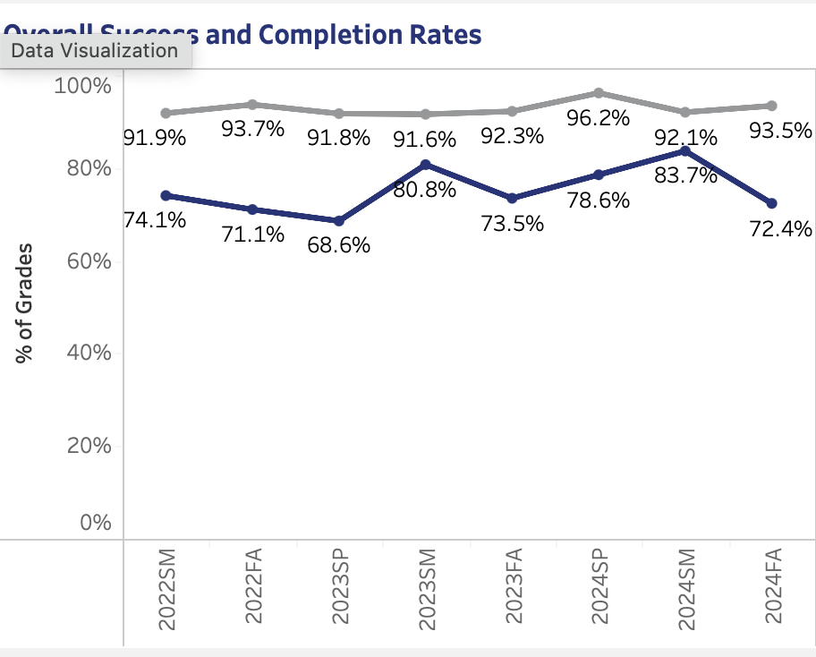
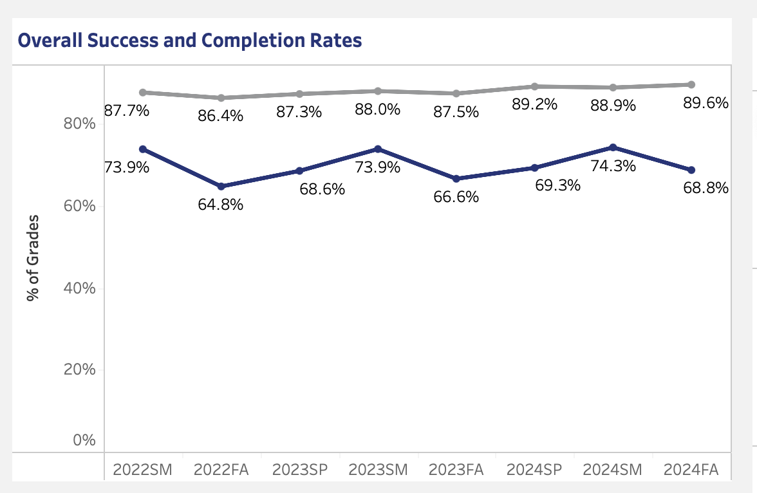
Success and Completion
FTVM Department
SBVC at Large
Notes:
Compare this to campus

Slide 13
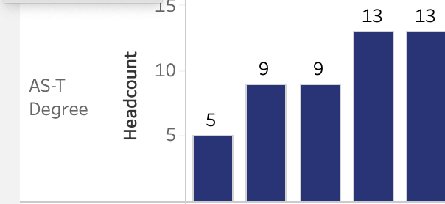
Transfer Degrees
19-20
23-24
Notes:
On average we total about 25 graduates a year, which includes certificates and our other degrees. Remember as CTE some of our graduates go right to industry

Slide 14
Fill Rate
23-24
Notes:
The fill rate has increased since that addition of the temporary full-time faculty.

Slide 15
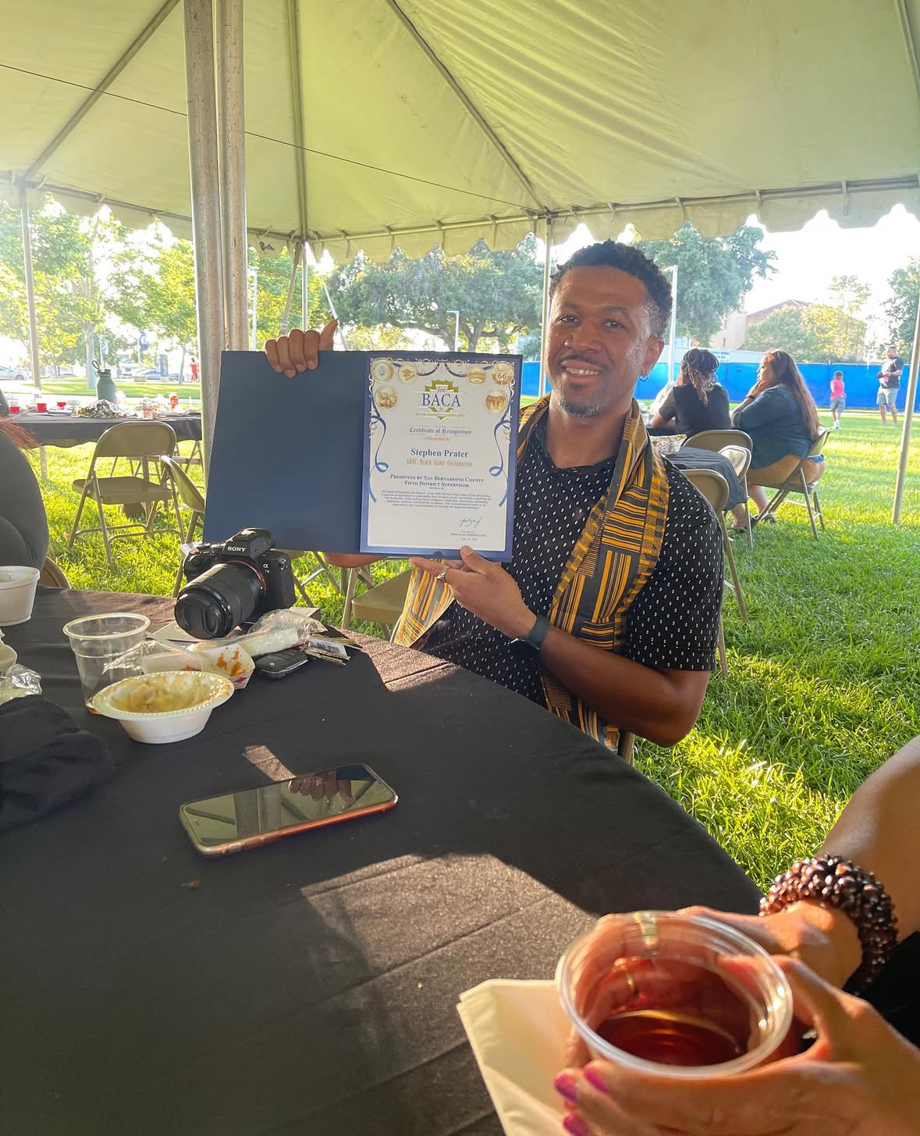
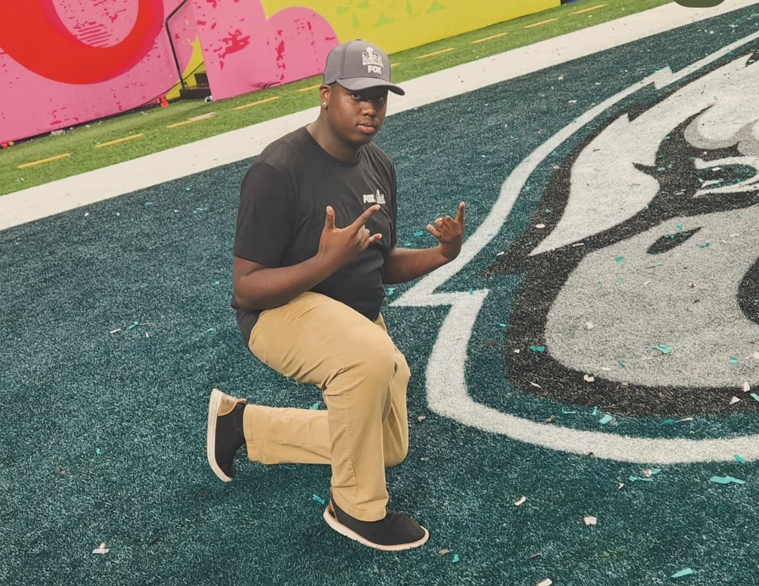
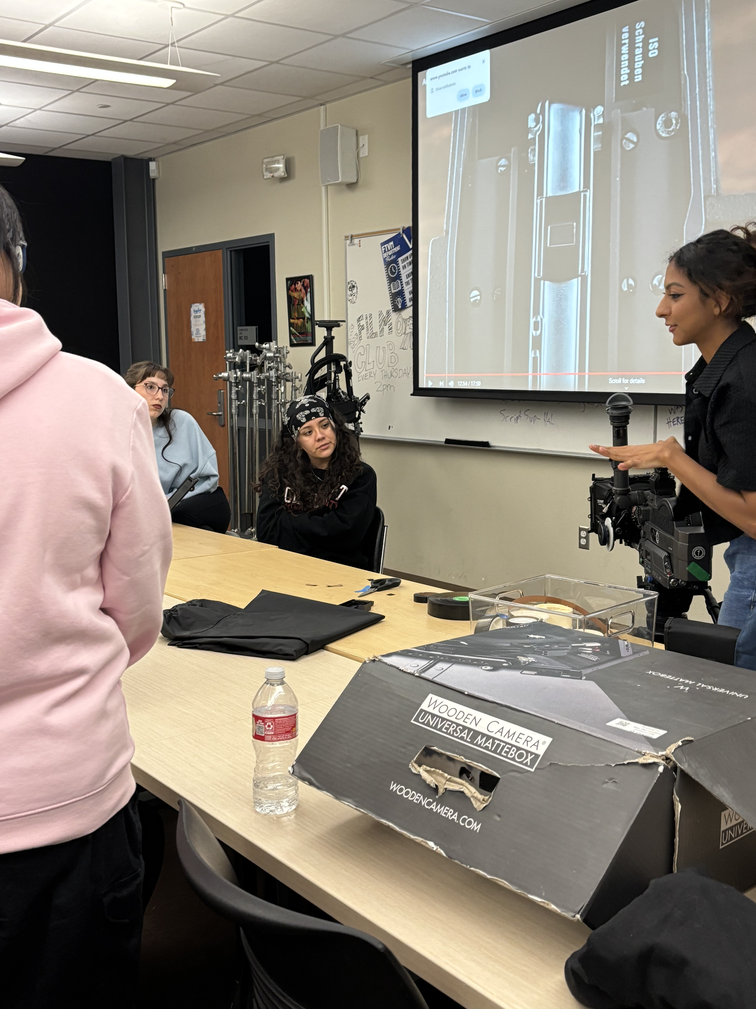
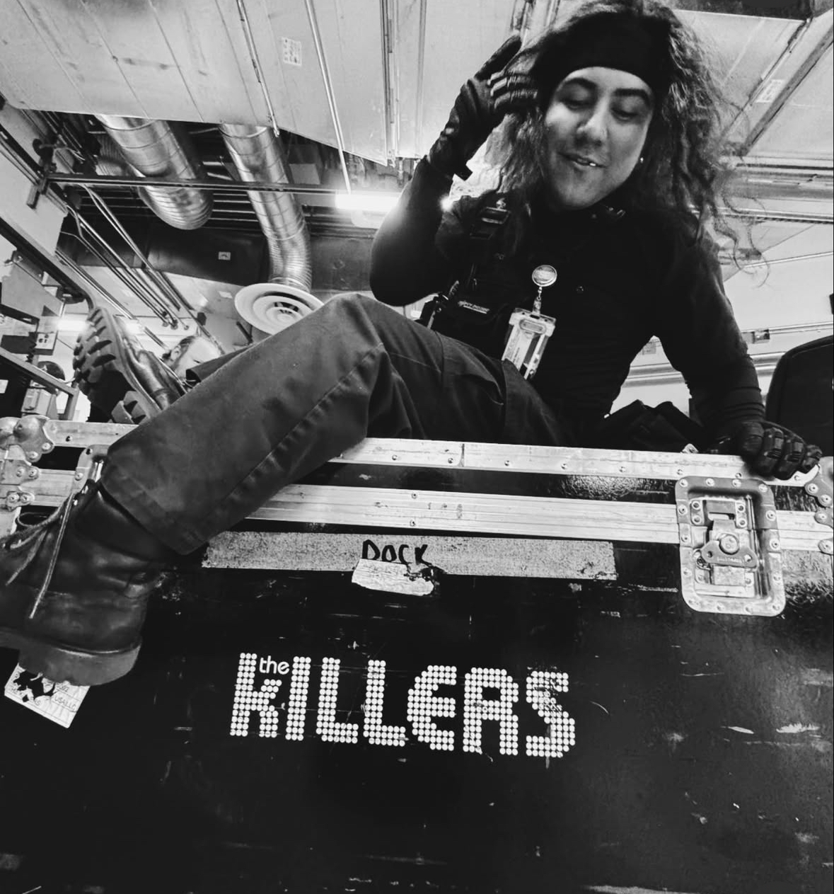
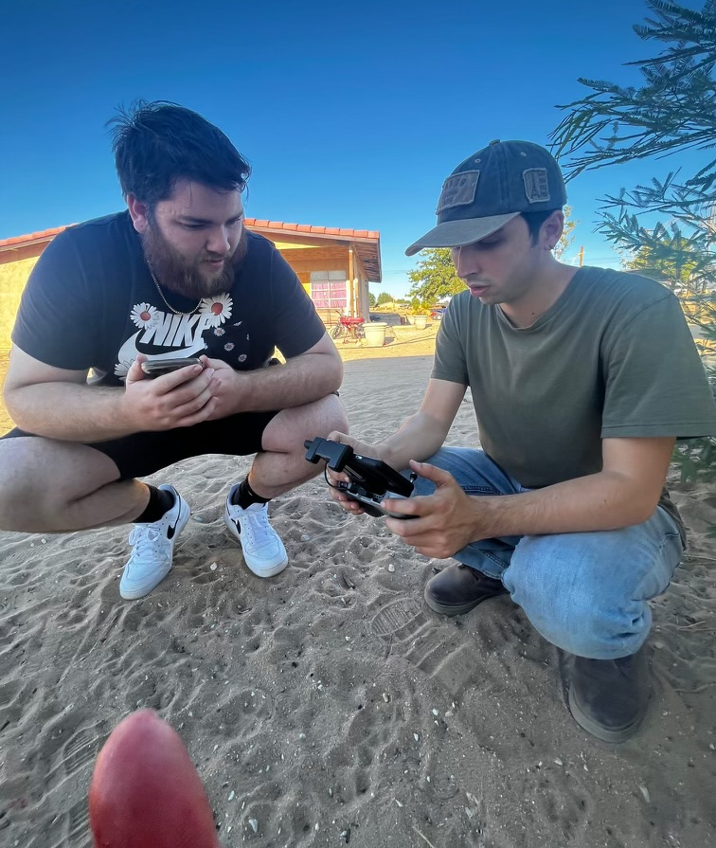
Lasting Outcomes
Imari ‘22– Fox Sports
Segment Producer
Stephan ‘23– KVCR/ESPN
CSUN – Doc Track
Briana – KVCR Producer
Mariana – FNX Producer
Mars
Isaac ‘22 – Yaamava'
Stagecraft and Video
Nic ‘21– SBVC/Ent. 19
FTVM Lab Tech./Producer

Slide 16
Q and A
Questions, comments, quips, quarries, or quotes

