Slide 1
Hiring & Recruitment Process

Slide 2
Title 5 Requirements/Changes:
1
All recruitment for employment positions conducted by the District including, without limitation, recruitment positions conducted by Human Resources shall be conducted consistent with all the requirements set forth in Section 53021 of Title 5 of the California Code of Regulations.
4
The District’s screening and selection procedures shall be consistent with all the requirements set forth in Section 53024 of Title 5 of the California Code of Regulations.
2
Human Resources shall create job announcements and set qualifications for employment positions consistent with all the requirements set forth in Section 53022 of Title 5 of the California Code of Regulations.
5
Designed to ensure consideration is given to the extent to which applicants demonstrate a sensitivity to and understanding of the diverse academic, socioeconomic, cultural, disability, gender identity, sexual orientation, and ethnic backgrounds of community college students.
3
Human Resources shall review the applicant pool and take appropriate action as necessary consistent with all of the requirements set forth in Section 53023 of Title 5 of the California Code of Regulations.
6
Based solely on job-related criteria; and designed to avoid an adverse impact, as defined in Section 53001(a) of Title 5 and monitored by means consistent with this section to detect and address any adverse impact which does occur for any monitored group.

Slide 3
Goals & Intent:
Eliminate Bias:
Qualitative & Quantitative
This new process eliminates the screening committee process which could have bias (both positive and negative) in hiring.
The educational benefits of workforce diversity.
Based solely on job-related criteria; and designed to avoid an adverse impact.
Using both qualitative and quantitative measures while applying the adverse impact analysis at each step, will help us reach our EEO goals of having an effective way to assess candidates.
Eliminate Artificial Barriers:
Eliminates the artificial barrier of “group think” and instead focuses on the candidate’s competencies.

Slide 4
Recruitment Process:
Vacancy or Position Established:
PRF is submitted to the Office of Human Resources to begin recruitment after all signatures have been obtained.
HR Generalist will reach out to the hiring manager to obtain the following:
Position Information: Hours, FTE, categorical funds, fund name
Desired Qualifications (DQ’s): Established by hiring manager and Subject Matter Expert (SME)
Additional positing information
Anticipated Hire Date
Hiring Manager will work with SME to help craft interview questions/presentation material
Job Posting:
Position will be posted internally for employees within unit for ten (10) days (if applicable).
Posting will be posted to public via NeoEd for thirty (30) days to establish a large pool of applicants.
The Adverse Impact tool will be used to ensure that the candidate pool is diverse. If the pool falls below the 80% ratio, HR and the hiring manager will collaborate to decide whether additional advertising is necessary.

Slide 5
Recruitment Process cont.:
Screening & Applicant Process:
The applicant pool will be screened by HR Generalist for minimum qualifications (MQ) which is pre-determined on job description/posting.
The San Bernardino Community College District has established the following hiring qualifications for all faculty positions: AP 7210
For faculty and administrative positions, job requirements shall include (A) a sensitivity to and understanding of the diverse academic, socioeconomic, cultural, disability, gender identity, sexual orientation, and ethnic backgrounds of community college students as demonstrated by skills and abilities in cultural responsiveness and cultural humility; and (B) a demonstrated commitment to recognizing patterns of inequity in student outcomes, taking personal and institutional responsibility for the success of students, engaging in critical assessment of own practices, and applying a race-conscious awareness of the social and historical context of exclusionary practices in American Higher Education.
The Minimum Qualifications for discipline expertise adopted by the Board of Governors for California Community Colleges or possession of a valid and appropriate California Community College Credential as provided in Education Code 87355.
All applicants will be provided the opportunity to have qualifications for discipline expertise reviewed and considered for meeting minimum qualifications that meet or exceed those listed adopted by the Board of Governors through alternate means.
If applicant pool is large, HR will reach out to hiring manager and/or SME (if applicable) to screen on desired qualifications.
Candidates will be invited to interview based on job-related criteria. Accommodations are provided.

Slide 6
Committee Makeup:
AP 7120 & AP 7210
Subject Matter Experts (2-3 SME’s):Individuals who possess deep knowledge, expertise, and experience in a specific subject or field. Determined by Hiring Manager.
The President of the Academic Senate, after consultation with faculty in the discipline of the position and with the appropriate Division Dean, will appoint at least 3 faculty to serve on the selection committee.
An Equal Opportunity Representative from the District HR-DEIA Committee shall be appointed.
The Committee should also include representation from those employees or employee groups who are served by or otherwise interact with the position. If a classified employee is selected to serve on the committee, the President of CSEA will provide the names of individuals nominated to serve as the representative from the unit. The hiring supervisor will select appropriate committee member(s) from those nominees.
The Screening Committee should normally have no fewer than five (5) and no more than nine (9) members.
A majority of the membership of the selection committee shall be faculty.
Every screening committee will include the Division/Department Dean or appropriate administrator or their designee.

Slide 7
Interview:
Questions, Teaching Demonstrations, Presentations or Writing Exercise:
Interview Questions will be created by SME(s) and Hiring Manager. Questions are reviewed and approved by the District Director, Diversity, EEO, Employee Wellness and Compliance.
Teaching Demonstrations, Presentations and/or Writing Exercise will be created by SME and hiring manager.
Interview Day:
Meet at the scheduled meeting time.
Interview candidate and fill out rubric based solely on interview, job-related criteria, and teaching presentation. No application material will be shared with committee.
Group discussion after all interviews take place: opportunity to provide feedback for second level interviews. No deliberations.
Applicants will move forward to second level interviews based on determined cut score.

Slide 8
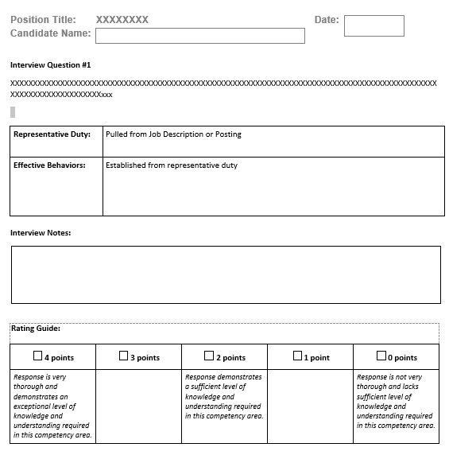
Sample of Rubric:

Slide 9
Questions?

