Slide 1
ASPIRE: All Services and Programs Resources & Engagement Process
Year 1 ASPIRE & Resource Requests Prioritization
YEAR 2 Updates & Schedule

Slide 3
Year 1 Workshop Timeline
Meta Demo
Library 109
Data Resources & SWOT Analysis
Resource Requests
Aug. 18
Sept. 29
Nov. 17
Sept. 15
Oct. 20
Jan. 10
Mission, Vision, Values
Planning & Goals
Closing Workshop

Slide 4
Feedback from Participants
The overall process is largely well received:
“I found this process to be much easier than previous ones!”
Appreciation for workshops and resource support in Canvas
Meta software can be confusing to operate – additional trainings necessary for next year
Some confusion about who should be participating
Many questions about resource requests

Slide 5
Year 1 Submission & Resource Request Timeline
Division Prioritization & PRC Rubric Scoring Due
Extended Submission Date
Requests sent to Deans for prioritization*
Jan. 26
Feb. 26
Mar. 13/15
Feb. 16
April
PRC Prioritization Commences
Invitations sent for listening sessions
Mar. 1
Calculation of rubric scores, final prioritization
Listening Sessions
*Delays in sending out to Deans over service areas

Slide 6
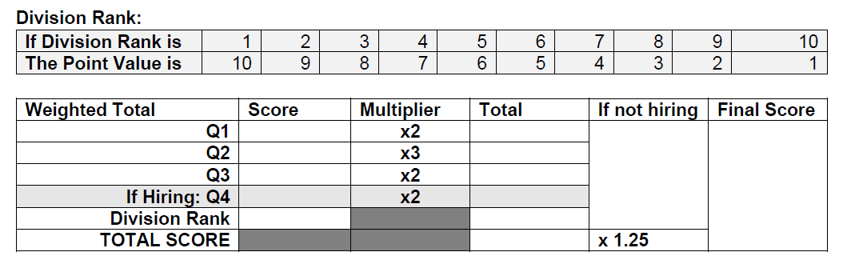
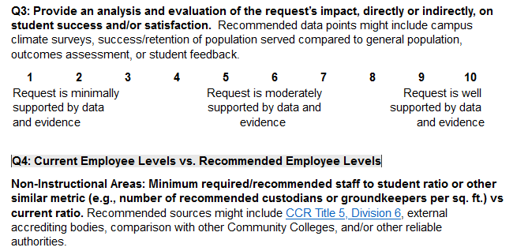
Revised Resource Request Ranking Rubric

Slide 7
Resource Requests Received
54 ASPIRE Program Submissions
- 10 without resource requests, 44 with resource requests
Equipment: 14 Programs, 24 requests
Facilities: 6 – Sent to Facilities committee for ranking
Technology: 7 – Ranked by Technology committee ✅
Budget: 22 requests
Management: 2 – Question whether should come to PRC
Faculty: 40.7
Classified: 40

Slide 8
Challenges & Requests
Challenges with new technology – delayed timeline
Challenges identifying which areas should participate, primary contact with upline manager, + mapping into new Meta system
Requests to Managers/Admin:
Create list of programs you feel should be participating with contact for your area and send to Committee Co-Chairs
Clarify to programs: which requests go through Program Review & where other requests go, provide documentation

Slide 9
ASPIRE Year 2 Plan: Fall 2024
Once program list is compiled & compared with 23-24 (Summer)
Programs identified as incomplete during this cycle or pilot requested to complete during Fall 2024 (Aug. – Nov.)
Resource requests collected for 24-25 cycle (Nov.)
Programs who completed pilot or 23-24 can roll-over or resubmit resource requests for 24-25 cycle (Nov.)
24-25 Resource request prioritization (Nov. – Jan.)

Slide 10
ASPIRE Year 2 Plan: Spring 2025+
Spring 2025: All programs complete Year 2 Cycle: (Feb. – Apr.)
DEIA Focus SWOT, Goals & Planning, 25-26 Resource Requests
Fall 2025: 25-26 Resource Request Prioritization
Spring 2026: ASPIRE Year 3 & Collect 26-27 Resource Requests
Fall: Request prioritization so funding can occur in Spring
Spring: Next ASPIRE cycle & collect resource requests to be prioritized in Fall

