Slide 1
SBCCD Common Application Project Status Update – February 23, 2023

Slide 2
I. Project Summary
Project Summary:
Allow Students to Apply to One College and Register for Courses at Either College
Project Kickoff in May 2022
Functional Meetings
Course, Program, Catalog
Application, Assessment, Ed Plans,
Financial Aid,
Registration, Degree Audit, Transcripts
MIS Reporting, 320 Reporting
Project Completion in October 2022

Slide 3
II. Project Plan

Slide 4
III. Functional Testing
Colleague Functional Testing
Application, Assessment, Ed Plan
Financial Aid Processes
Registration at Both Colleges
Degree Audit and Transcripts
MIS Reporting, 320 Reporting

Slide 5
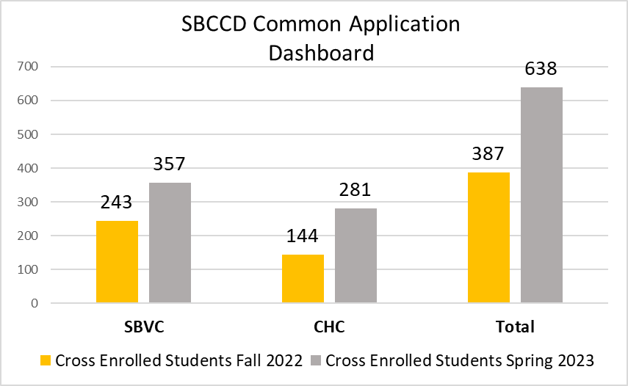
IV. Current Status

Slide 6
V. Next Steps
Phase II Projects
Ongoing Course Review between Colleges
Laserfiche to CCCApply Assessment Submission

