Slide 1
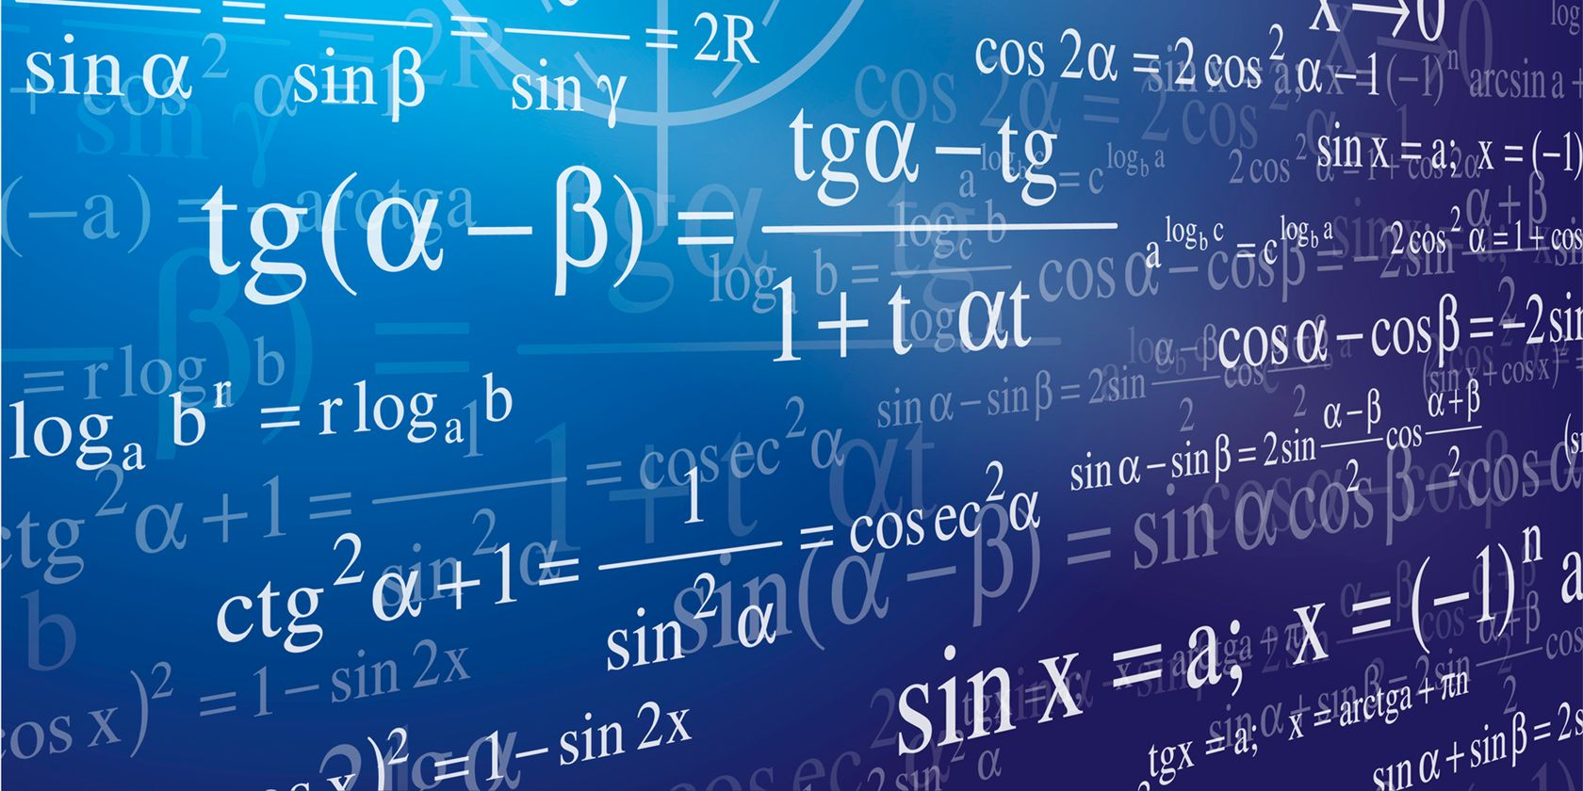
Math AB 1705 Compliance Update

Slide 2
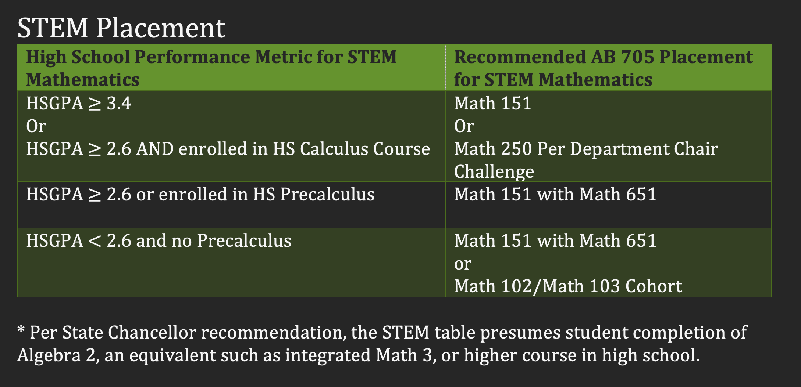
By July 1st, 2023, a community college shall not require students to repeat coursework that they have successfully completed in high school or college or take coursework that repeats competencies that the student has demonstrated through other methods of credit for prior learning. STEM students who have successfully completed precalculus in high school shall have access to calculus if their program requires calculus.
Math 102 (College Algebra)
Math 103 (Trigonometry)
Math 151 (Precalculus)
Math 651 (Precalculus Support)
Math 250 (Calculus 1)
Issues:
1. Students that have taken precalculus in high school can possibly be placed into Math 151.
2. Students that have taken trig in high school can possibly place into Math 103.
3. Students that have taken AP Calc in high school can possibly place into Math 250.

Slide 3
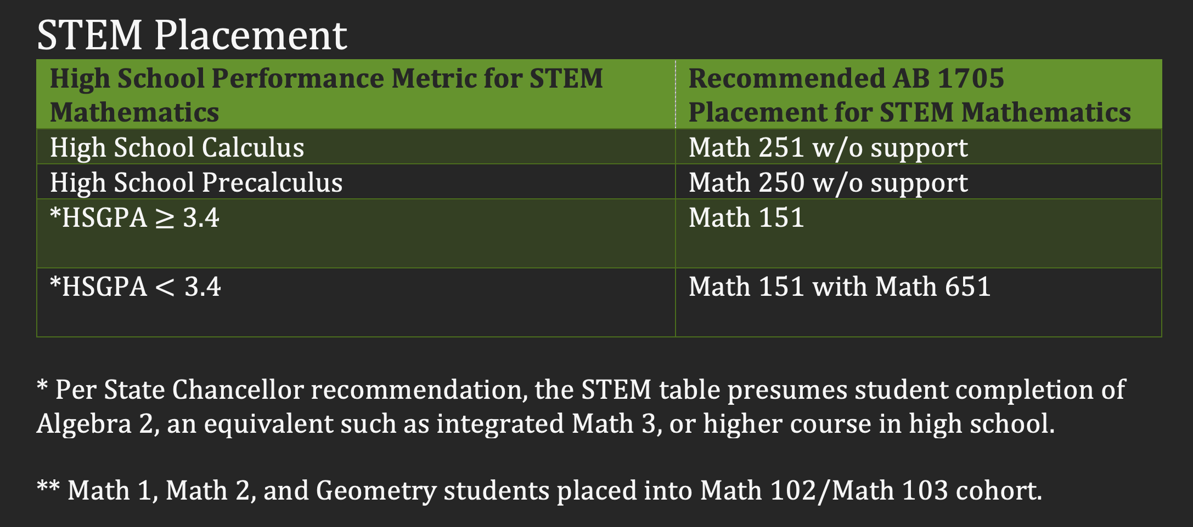
New Placement
Math 102 (College Algebra)
Math 103 (Trigonometry)
Math 151 (Precalculus)
Math 651 (Precalculus Support)
Math 250 (Calculus 1)
Math 251 (Calculus 2)

