Slide 1
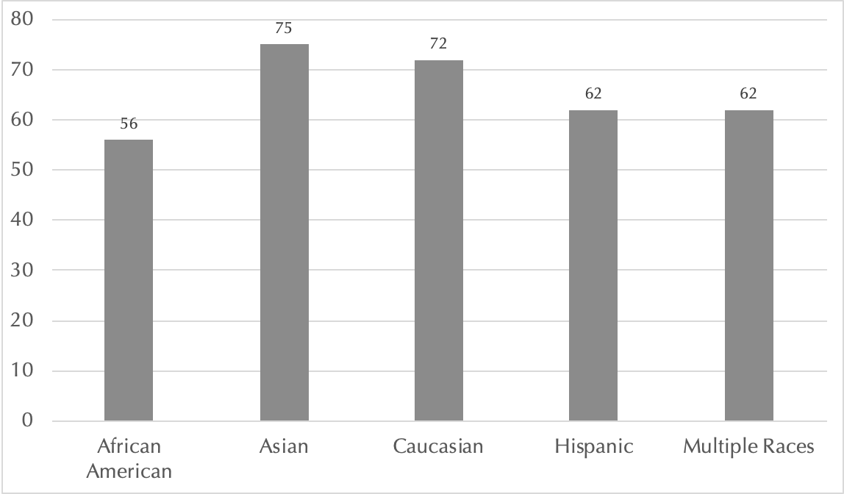
Quick Reminder: Why are we (educators) here?
SUCCESS by race/ethnicity Biology DEPT

Slide 2
Our Rules for Engagement

Slide 3
Engage honestly
Speak for yourself
Refrain from personal attacks
No rank in any room
No dominating – move up and move back to give others an opportunity to engage
Do not avoid subjects when they become uncomfortable for you
Be present, be active

Slide 4
Reading Analyses of Articles

Slide 5
Break-out: Problem-Solve

Slide 6
Our Classrooms are Racialized Spaces
“Everyone can succeed in this society, if they work had enough”

